Slide 1
Master class
Gome Galily

Slide 2
Introduction.
Gastro side of Dining effect .
Food in social media.
Trend in food + influences.
Entertaining presentation.
Presentaning
Question and general .

Slide 3
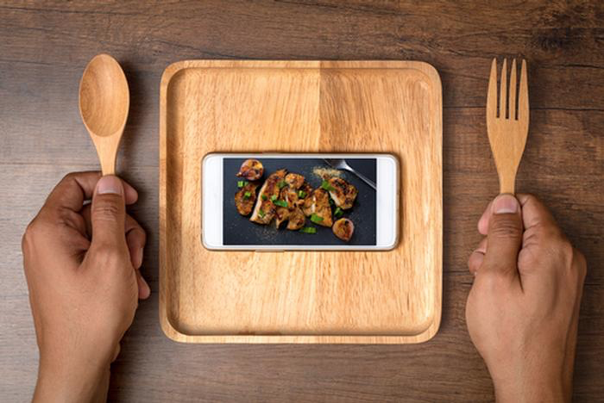
FACT
Over 208 million Instagram posts have been hashtagged "food" on the photosharing app since it was founded in 2010. This has compelled restaurants, food growers and the retail market to pay attention.

Slide 4
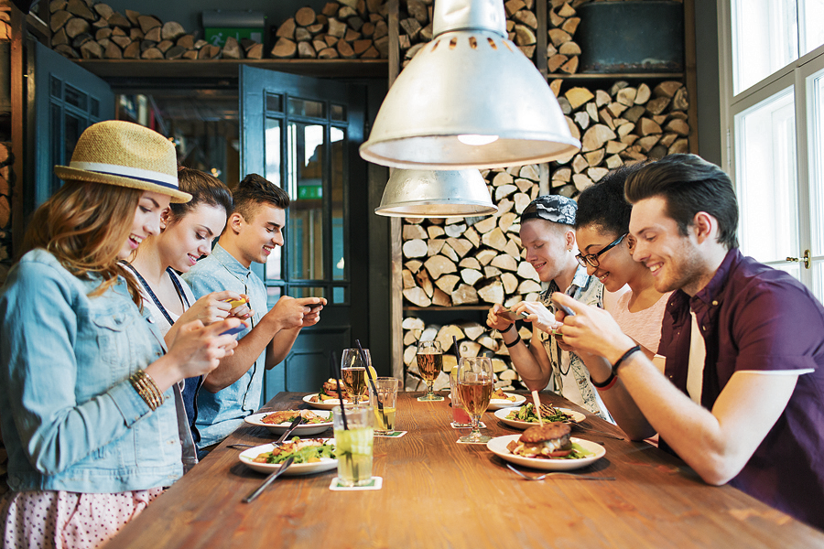
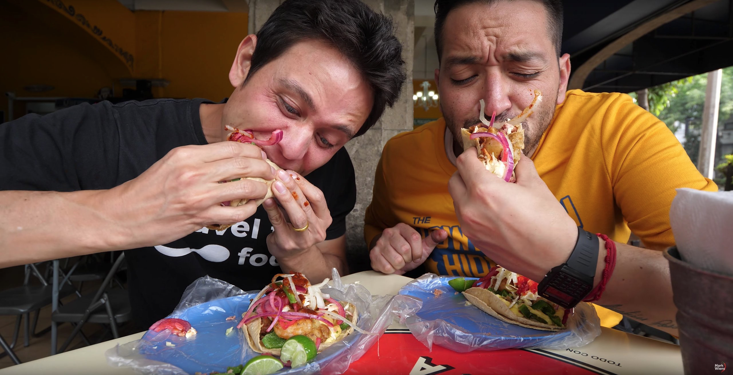
introduction
you are not just here to make food, you here to cook! delicious ,balanced, healthy and personal, this food should lift people mood, create memory and bring joy!
Feet your “playground” to the food you want to present and make sure they are pillar to itch other !
you would like to see people receiving the plate ,taking the phone out, taking couple of photos then they taste the food, joy need to appear on them face ! that's the kpi !

Slide 5
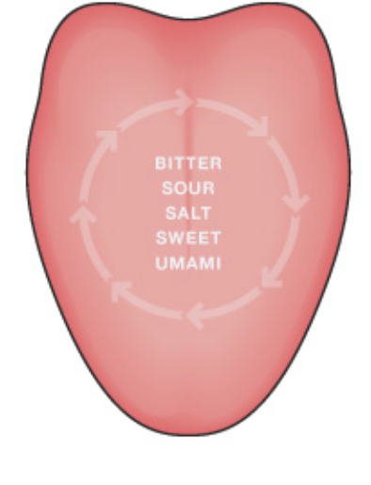
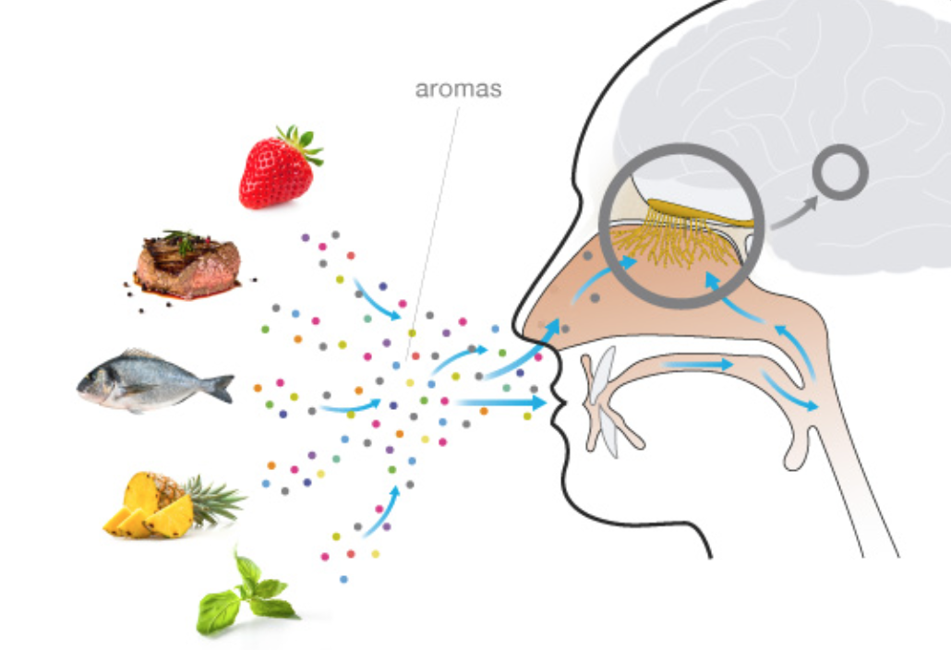
only around 25% of our flavor experience is due to taste and touch. visual is one key and most important is our sense of smell.
the dinning effect
It's long been understood that our experience of food is a complex story and evolves all our 5 senses. Even though sight impact of colors, well presentation of food, expectation of crunchiness(texture) affect our perception. there is no doubt that our flavour experience is mainly made up of the main sensations of look, touch smell &.taste,
The sense of taste is easily connected to our flavour experience. While tasting food we detect the 5 basic tastes in our mouth and on our tongue: sweet, salt, bitter, sour and umami.
The feeling we experience while biting and chewing our food makes us experience texture, freshness and pungency/spicy.

Slide 6
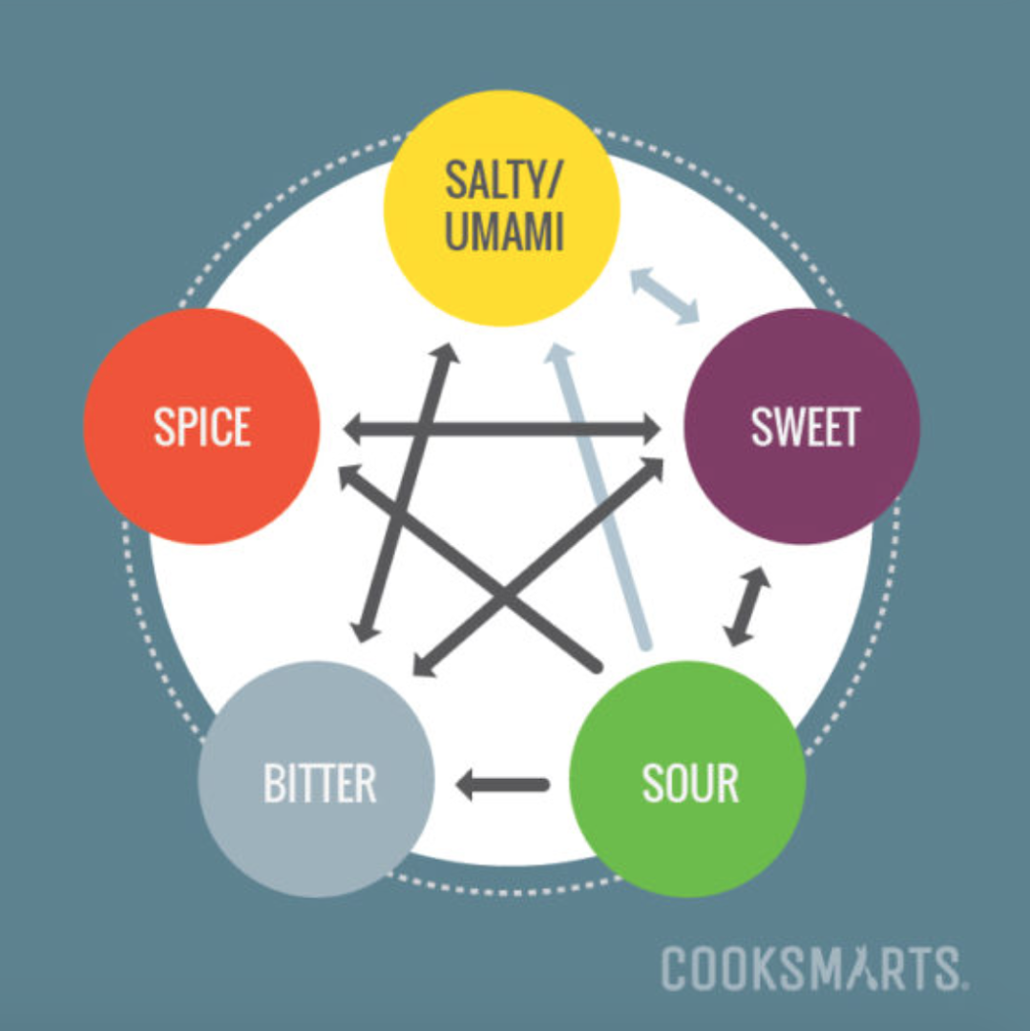
5 Taste element
the 4 main taste are- salty, sweet, sour, bitter/spicy
Itch one of them represent different element in your dish and combine to create something new.
when we or nature balanced all of those 4 together we create the 5 savoury ( umami)
If a flavor balances another flavor, it means it counteracts or offsets that flavor to achieve an even more harmonious taste. For example,
Understanding how to combine and balance flavors is an important cooking concept that will allow you to create flavorful dishes every time you cook.

Slide 7
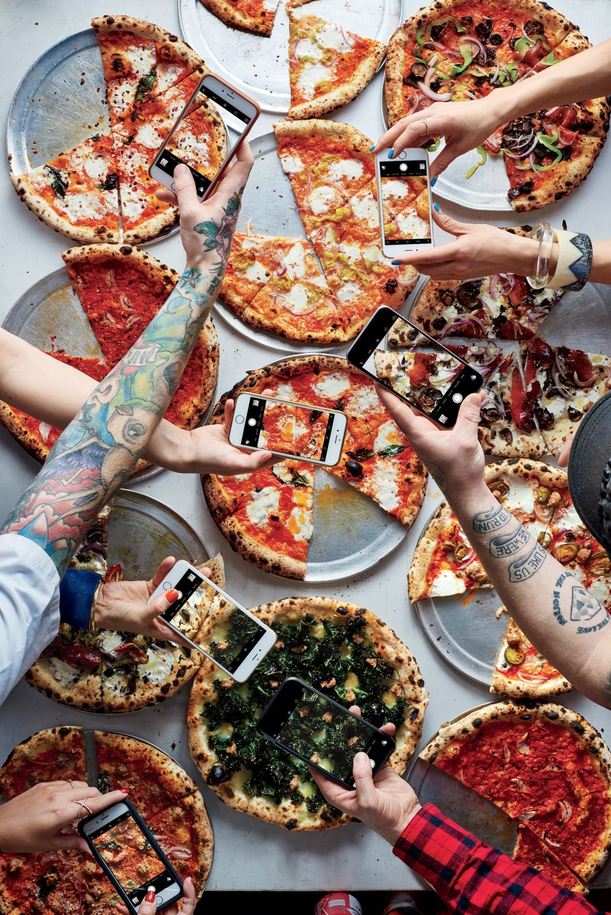
Food in social media
in the f&b industry of generation Y , iPhone and Instagram.
The dining experience turn in to social thing , food get more creative , presentation being entertaining and open kitchen turn in to almost a must in modern restaurant .
almost all my carrier i was working in a touristy/vacation/party places , and often i would entertain my guest with all different way , it could be story about the history of a dish, it could be dish in a customer (something that look like something else) of the dish , the colour , element of surprise and more ....
Most people need a few good picture/video for instagram and half job done , and as well there is benefit for chefs and service people , almost everyone would prefer open kitchen, as A chef i would wish to entertain my guest as much as possible , i would show a couple of alternating ideas and way to make meal in to a performer .

Slide 8
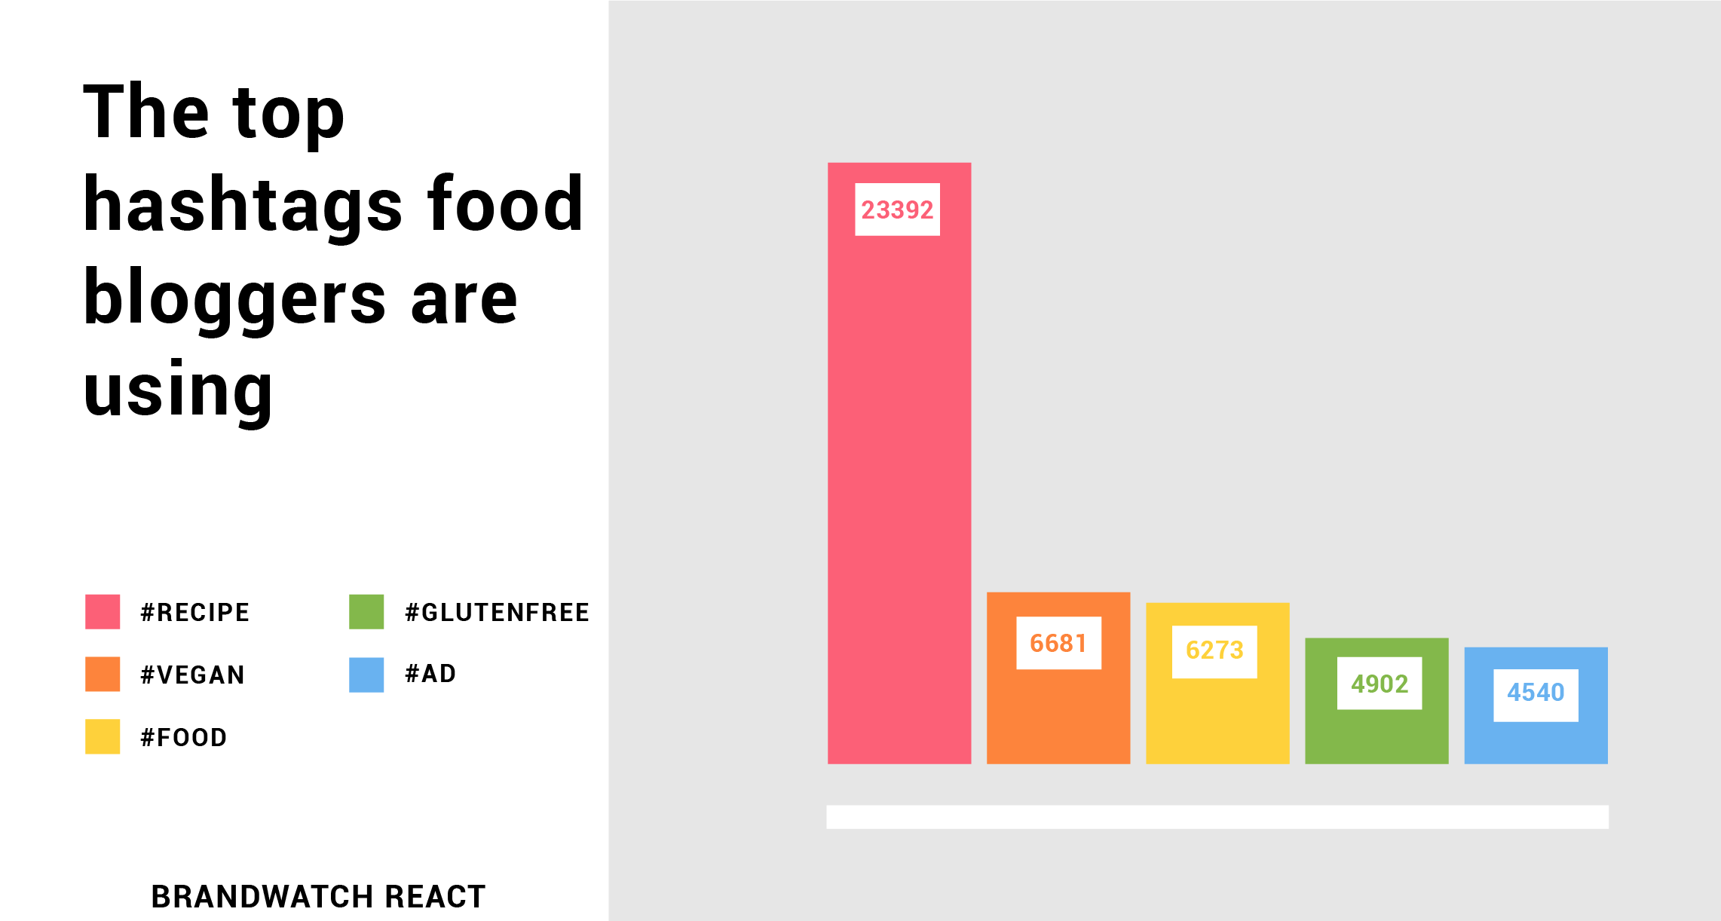

Trends and influences
Trends - healthy, vegan/vegetarian , organic , AGRICULTURE. israeli/portuguese/asian...
If you’re wondering what tasty new products will be flooding shelves and restaurant menus in 2018, don’t worry,We’ve sipped and snacked our way through the latest innovations to determine what you’re going to want to get your hands on this year
Influences -
Whether they’re promoting over-the-top indulgences or healthy, “clean” eating, there’s no denying that food bloggers and influencers have worked their way into the hearts (and feeds) of millions of people.

Slide 9
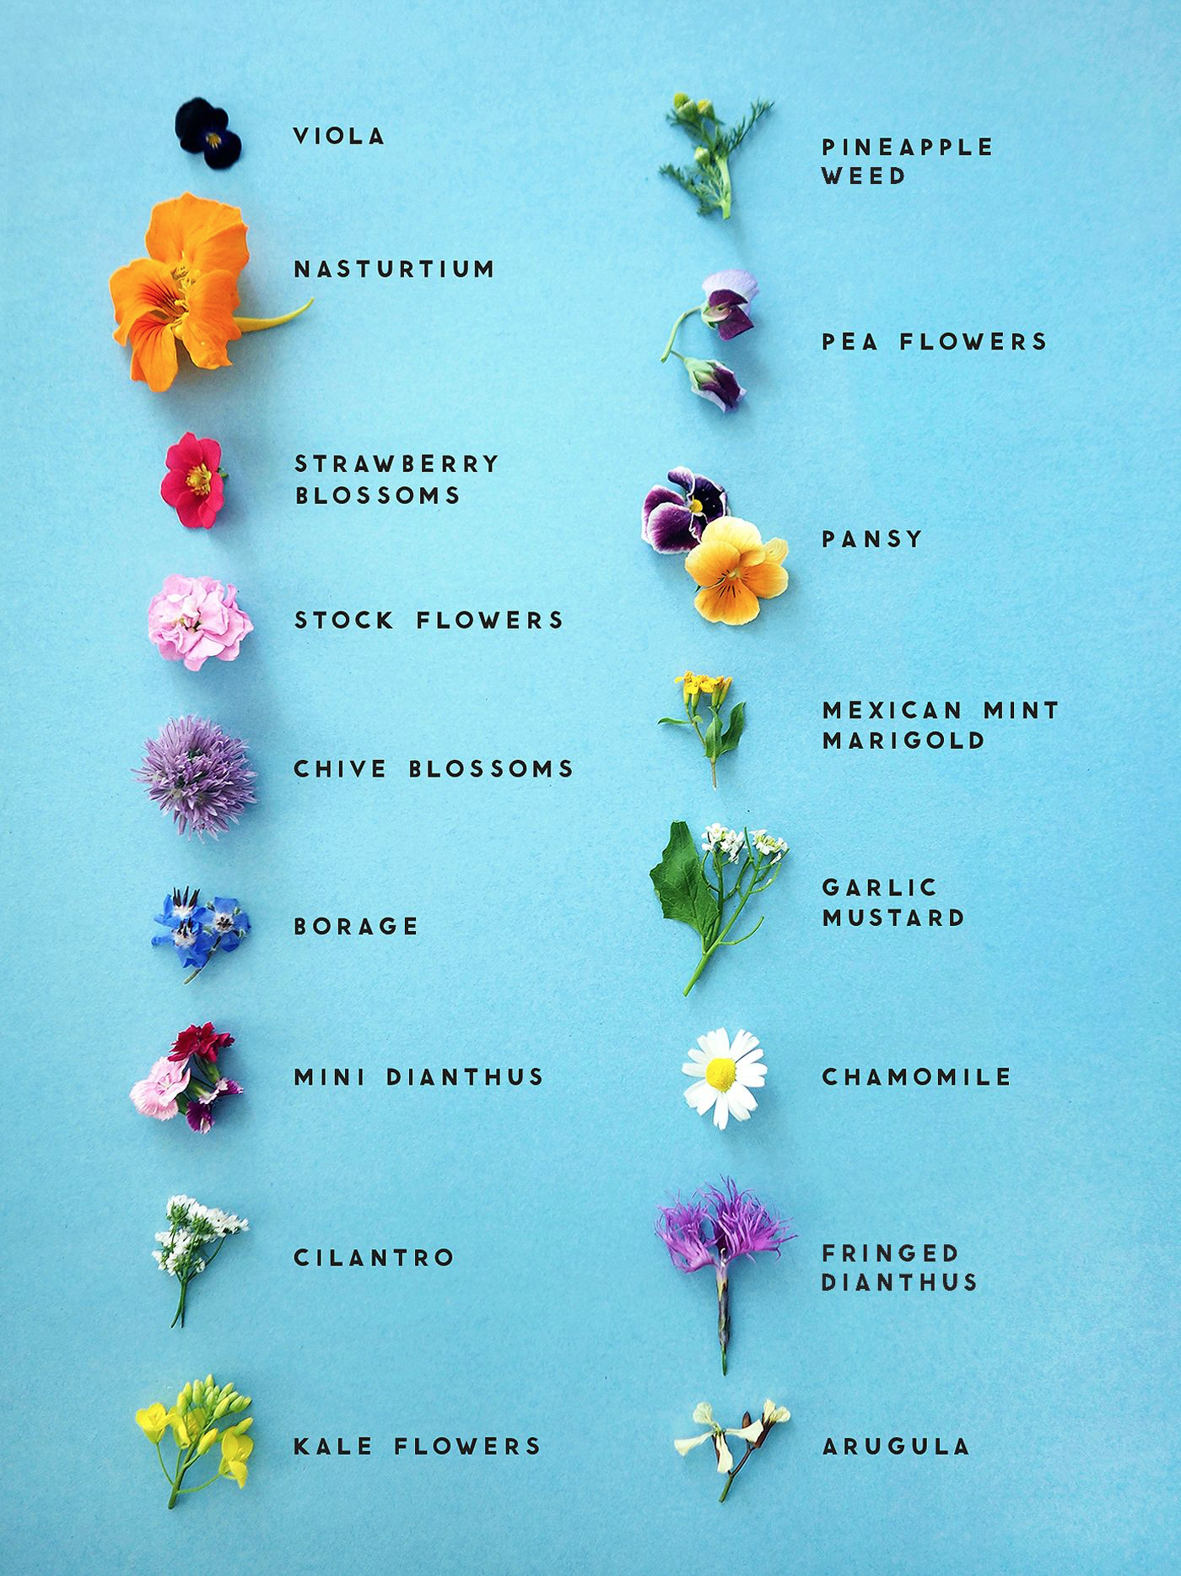
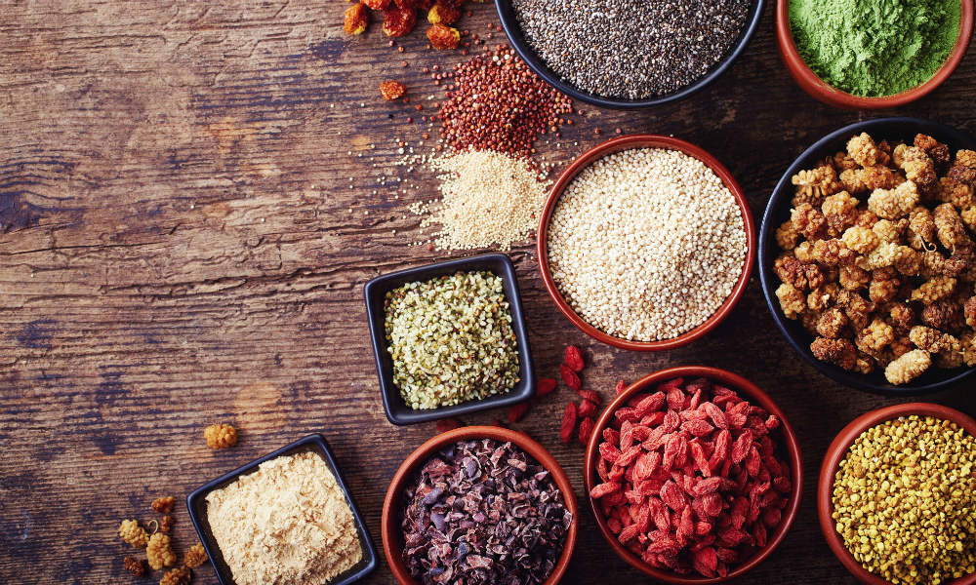
2018 Food and restaurant trends
1.Floral Flavours
The giant believe that more and more home cooks and companies will begin to add flowers into dishes to add actual flavour rather than as decorative notes. They’re predicting things like Lavender Lattes, Teas with Hibiscus, Elderflower everything and and they say we should be watching out for “rose flavoured everything.” The company also point to some interesting food mashups such as marshmallow and violet.
2. Super Powders
This has already started happening, think matcha, maca root, cacao, turmeric powder, spirulina, kale, herbs and other roots. The company is predicting powders galore for 2018 as consumers look to kick up their creations with simple powders to enhance their health attributes and flavours.

Slide 10

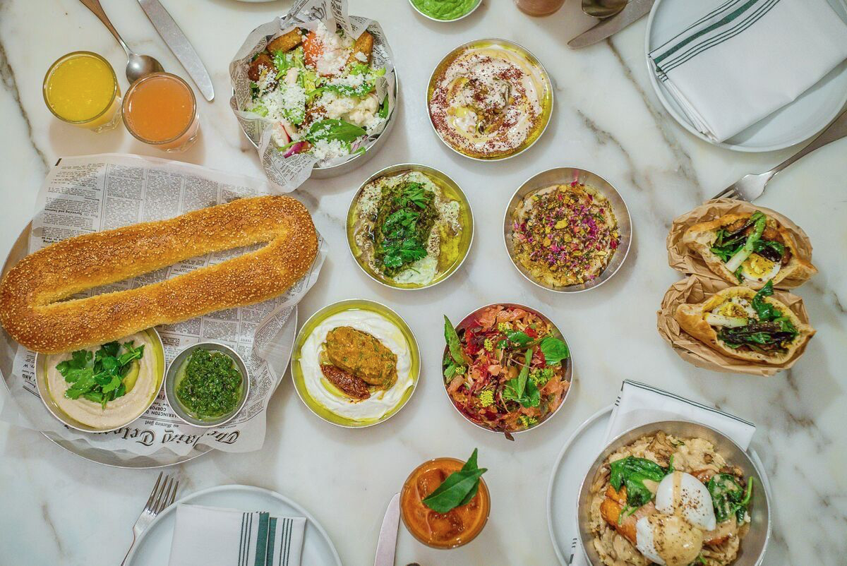
2018 Food and restaurant trends
3. Functional Mushrooms/ fangos and other fermentation
Another trend being pushed by health conscious consumers is that of mushrooms making their way into all sorts of products. Drinks like coffee, tea, smoothies are being packed with mushrooms like reishi and chaga.
4. Feast from the Middle East
They say consumers are looking to go beyond hummus, pits and falafel - instead they want to start to discover more regional dishes from the Middle East. This is leading them to predict a rise in a number of ingredients: harissa, za’atar, parsley, tahini and dried fruits are just a few. They also predict a focus on Persian, Israeli, Moroccan, Syrian and Lebanese cuisine.
5.New Cuts of Meat
Instead of such traditional fare as New York Strip, ribeye and filet mignon, some steak restaurants are expanding their repertoire to include new cuts like Vegas Strip steak (cut from the cow’s shoulder area), Merlot cut (from the cow’s heel) and Bavette, picanya, and denver cut .

Slide 11

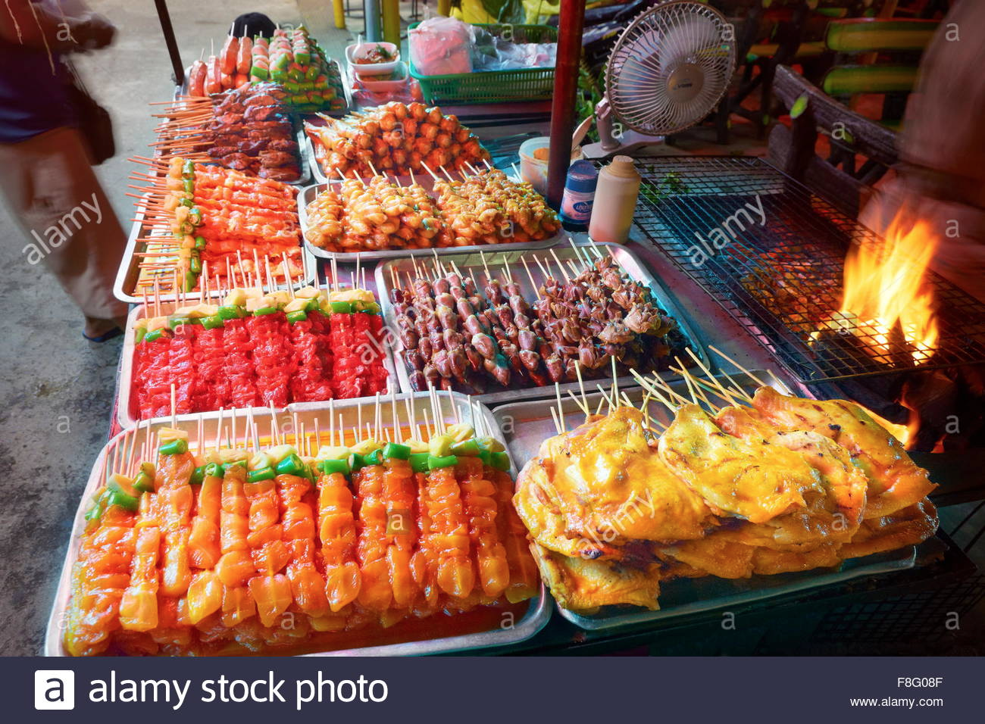
2018 Food and restaurant trends
5. International Breakfast Fare
Ever get tired of the traditional American/english breakfast of bacon, eggs, pancakes or cereal? Some diners are branching out and exploring new ways to start their day at restaurants which cater to more exotic breakfast offerings such as grilled fish, miso soup, steamed rice, Asian pickles and seaweed or brunch with almond whiskey buns, corned be
6.Street Food Inspiration
Think of street food in european country and you might conjure up visions of hot dogs, cheap pizza eco. But in recent years international street food has grown in popularity and the variety and quality is extraordinary. As well as more and more chefs are taking the new idea from street food .

Slide 12

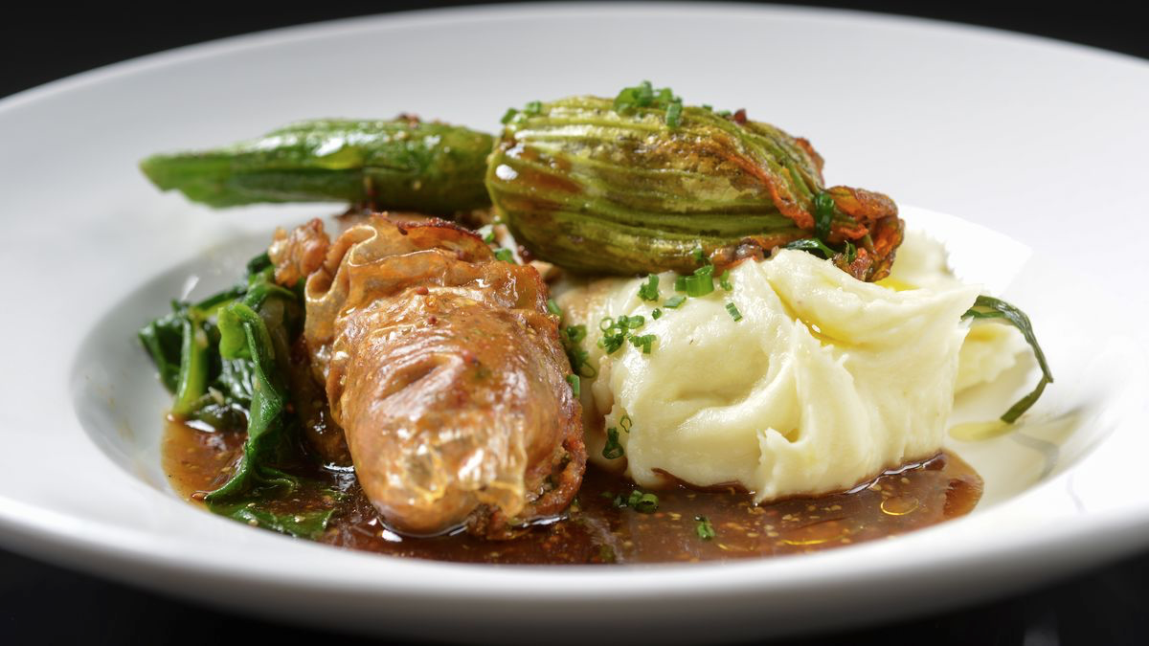
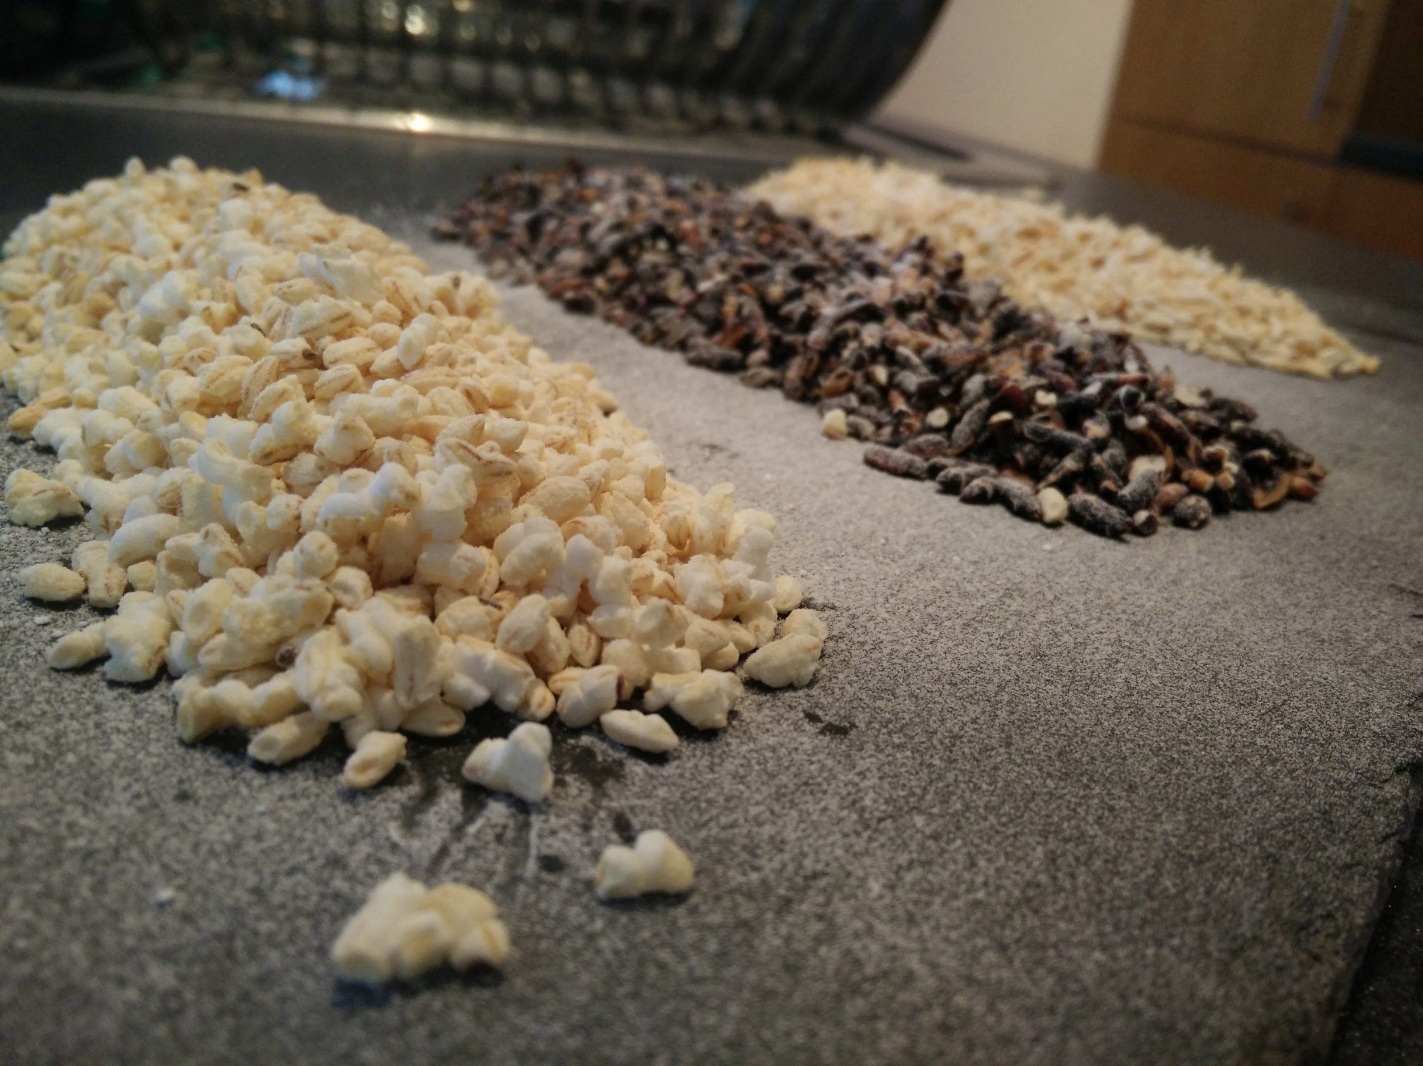
2018 Food and restaurant trends
7. High-Tech Goes Plant-Forward
As impossible foods create burgers so delicious they can please even the most discerning meat eaters, Whole Foods in predicting more plant and protein based products created thanks to high-tech innovations. More dairy free products that taste as good as dairy alternative, new plant based yogurts and more varieties of nut milks.
8. Puffed & Popped Snacks
Citing new developments in food technology, the company say that there’s some clever new extrusion methods (ways of combing ingredients). This means all sorts of new popped goods: expect more vegetable crisps, puffed pasta, puffed seaweeds and flavoured puffed rice.

Slide 13
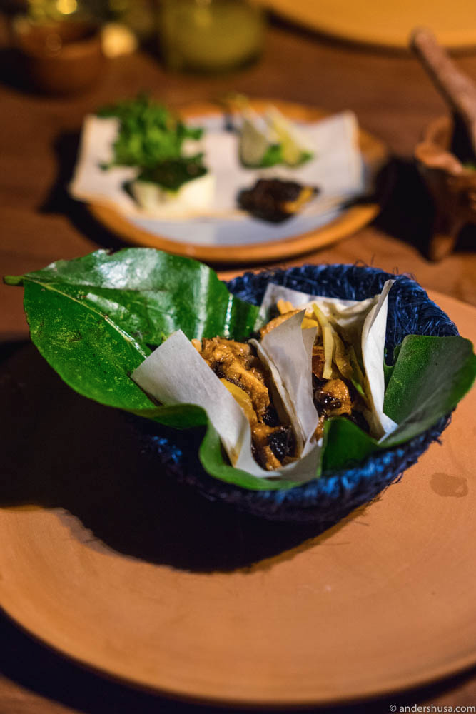
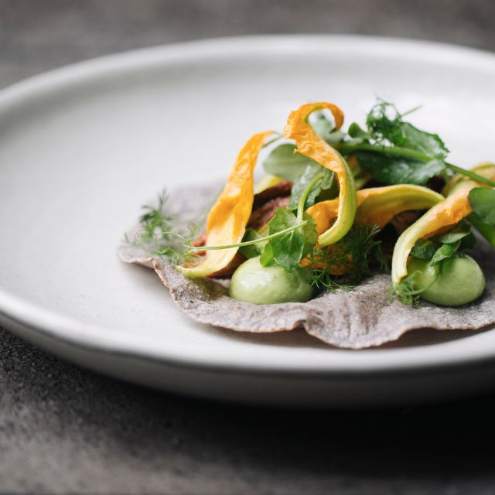
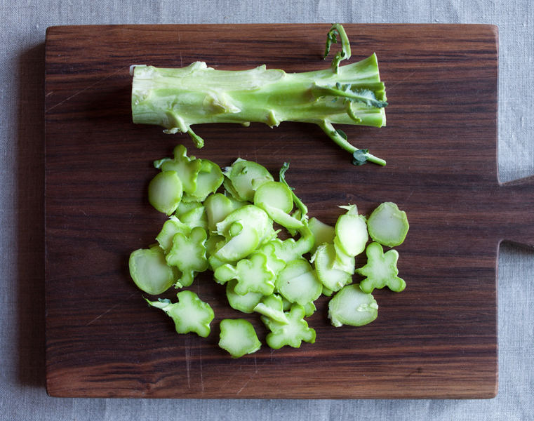
2018 Food and restaurant trends
9. Tacos Come Out of Their Shell
The company say the taco is changing, they’re speaking about more and more people choosing to use the taco for more than savory dishes, so expect taco desserts. They’re also speaking about the evolution of the tortilla as more and more people look to buy varieties made with heirloom corns. They also say we should expect more leafy greens, lettuces and seaweeds to start housing our tacos in 2018.
10. Root-to-Stem ( no waste )
Root-to-stem has been alive and well for a long time within the high-end restaurant industry, but Whole Foods is predicting this to start having an impact further down the food chain. Food waste was one of the most hotly debated topics of 2017 and you can expect food producers to jump on this growing trend. Expect pickled watermelon runs, pesto made from vegetable stems and a whole host of new products that make ingenue uses for food waste.
1

Slide 14
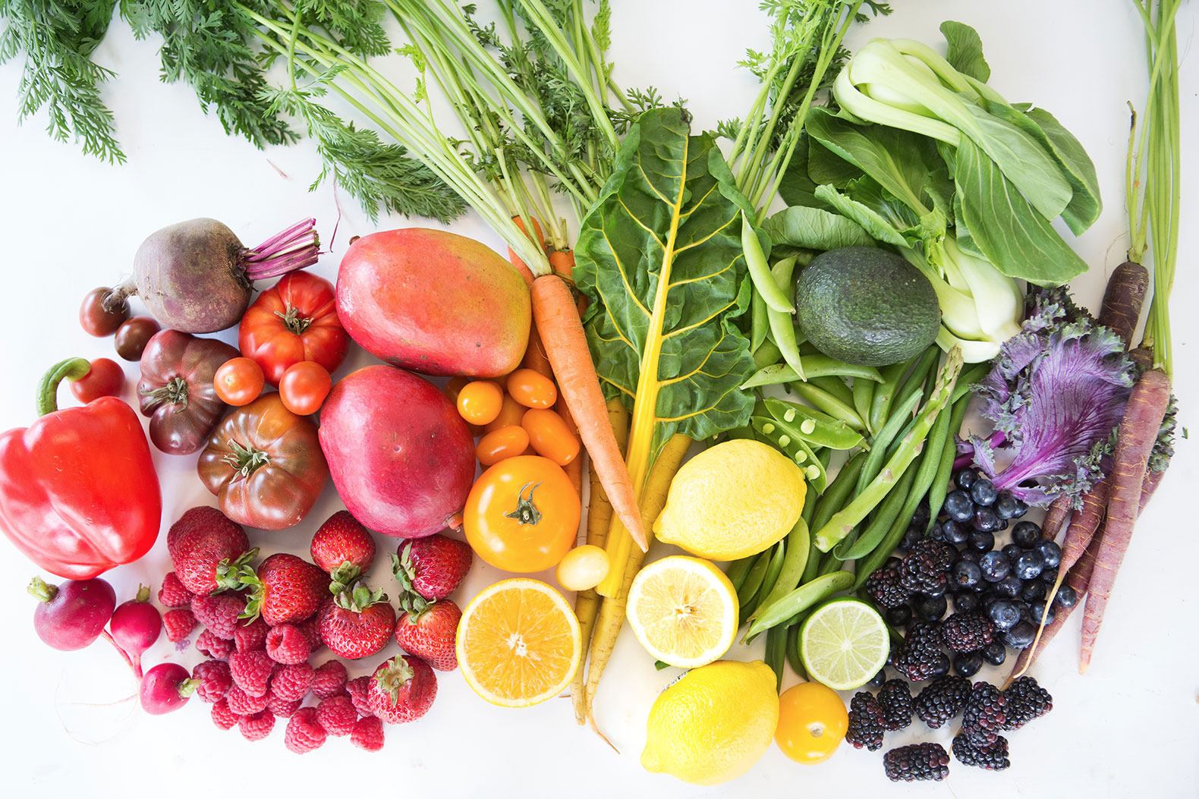
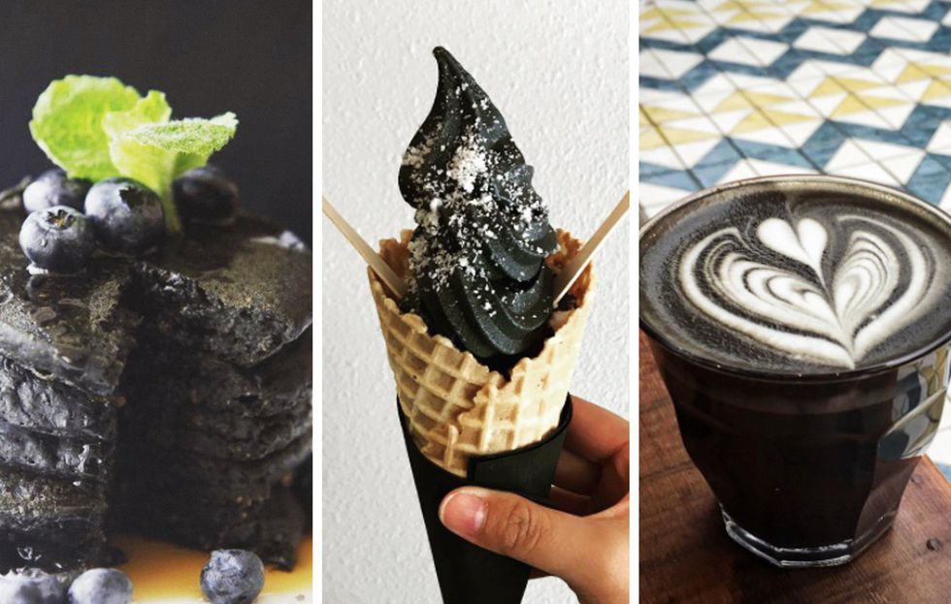
2018 Food and restaurant trends
11. Sustainable Seafood
The National Restaurant Association and several top chefs foresee a number of exciting changes on the horizon including an increased emphasis on sustainable seafood. This means avoiding overfished species, questionable harvesting practices and damage to marine habitats in favor of local and responsibly-farmed and caught fish and seafood
12.Activated charcoal—typically created through heating carbon-rich materials like peat, wood, coal, and even coconut shells at really high temperatures—has made its way into your grooming routine, popping up in skin care products and toothpaste. Now it's going one step further: into your food.

Slide 15
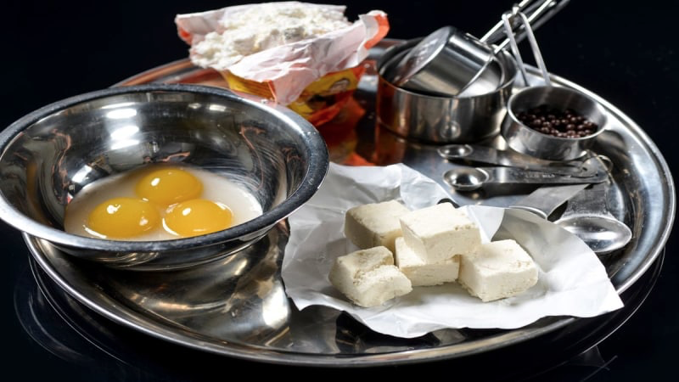

Slide 16
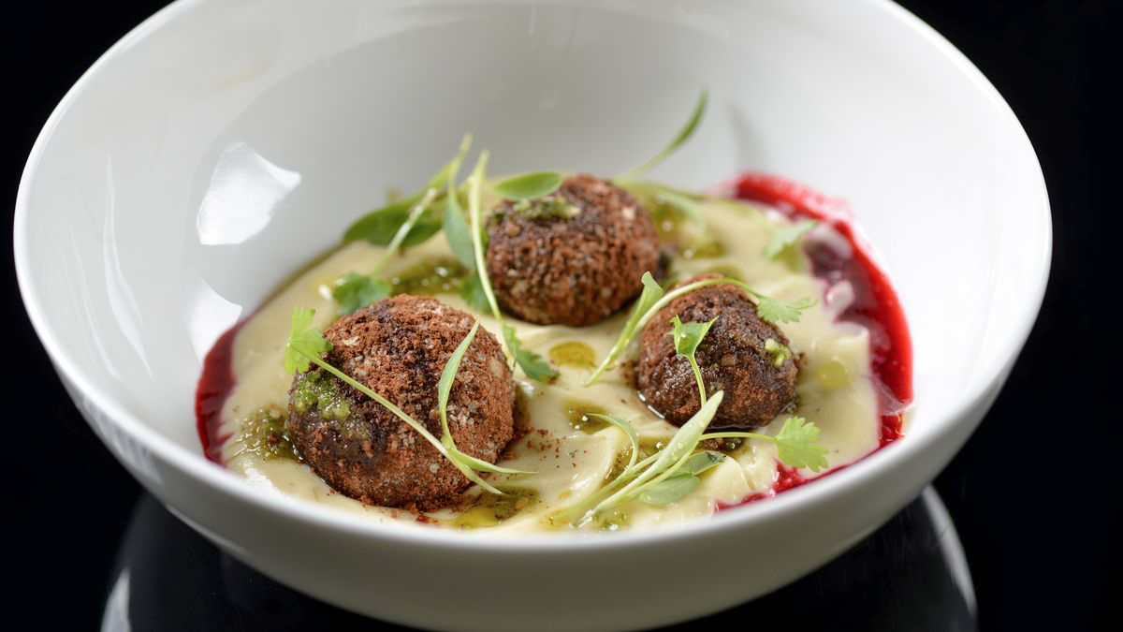

Slide 17

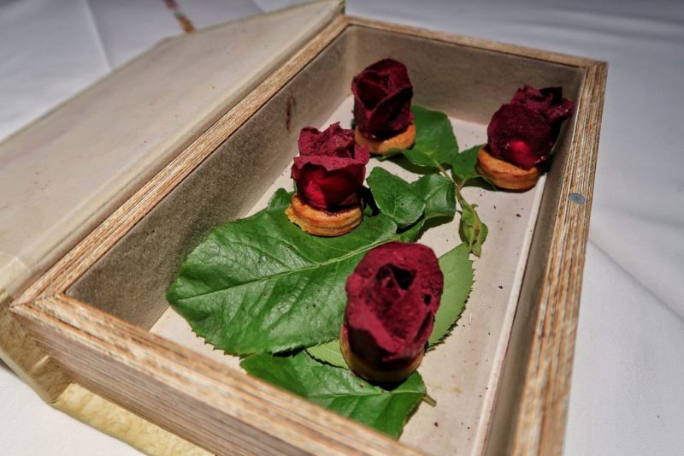

Slide 18


Slide 19
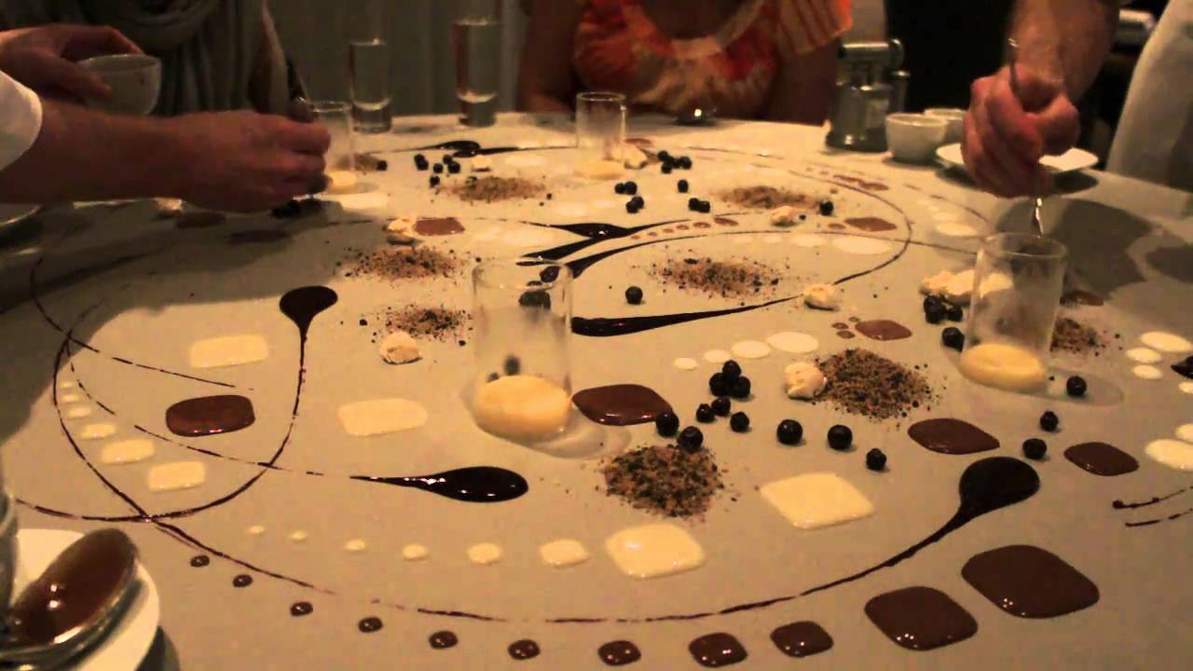

Slide 20


